Slide 1
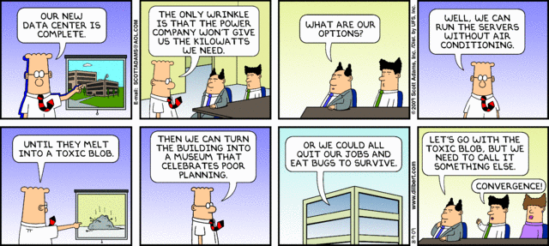

IST346: Server and Server Operating Systems

Slide 2
Agenda
Understand the difference between servers and workstations
Discuss the common IT issues surrounding servers, including server virtualization
Outlay the various types of servers and operating systems

Slide 3
Servers vs. Workstations

Slide 4
What is a Server?
A server is a computer that supplies services to users via other computers, called clients. The clients are usually workstations (but not always).
A service is the function of the server. Services are what differentiates a structured computing environment from bunch of standalone computers on a network.
Popular services:
Infrastructure: DHCP, DNS, Authentication, LDAP
User: File Sharing, Printing, Web, Database, Email

Slide 5
How are they different?
A Workstation has…
A Server has…
One “concurrent” user
A broad range of roles
Email, Web, Word, etc…
Hardware optimized for interactivity
Reliability and uptime are lower priority
Several “concurrent” users
A narrow range of roles
“File” server / “web” server
Hardware optimized for background processing
Reliability and update are high priority

Slide 6
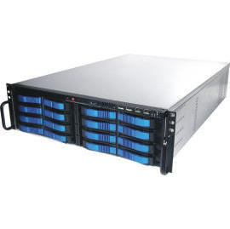
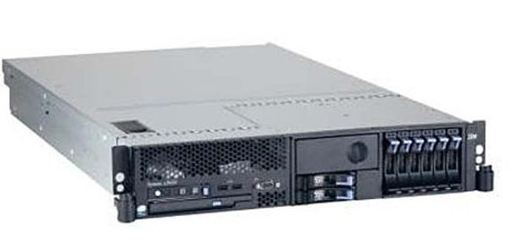
What Makes a Server a Server?
Server hardware:
Extensible/expandable
Increased performance (multiple cpus/cores)
High performance I/O (input/output)
High availability
Maintenance contracts
Management options
Services!!!

Slide 7
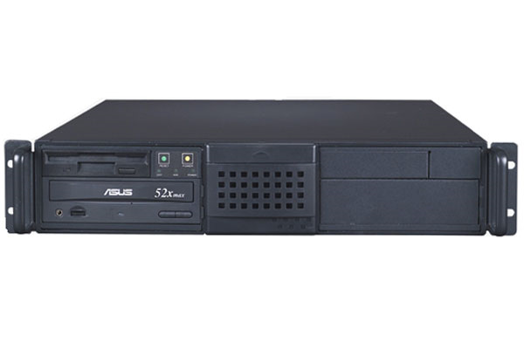
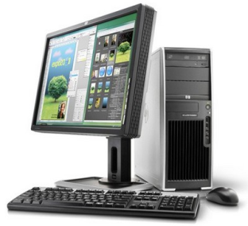
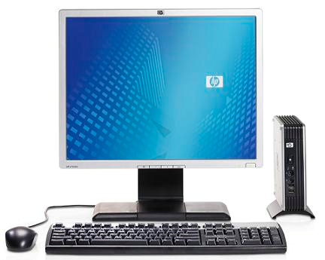
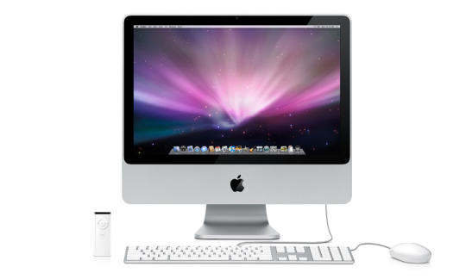
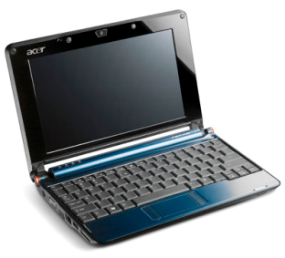
The Client-Server Model
filer.fauxco.com
192.168.1.10
Server
Workstations
ctl02.fauxco.com
192.168.1.202
ctl03.fauxco.com
192.168.1.203
ctl04.fauxco.com
192.168.1.204
ctl05.fauxco.com
192.168.1.205

Slide 8
Servers and their role in IT

Slide 9
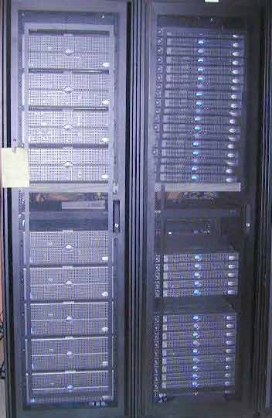
Servers:
Service 100’s if not 1,000’s of users
Require high reliability and security due to lengthy required uptimes for services.
Are expected to last longer than workstations
Cost much more than workstations
Cost accounting for servers is spread over the users who use them, not responsibility of IT.

Slide 10
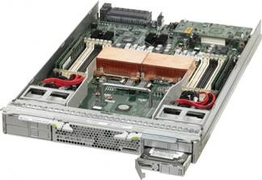
Servers:
Have different OS configurations than workstations
Are deployed in a data center
Have disk backup systems
Have maintenance contracts with the Vendor

Slide 11
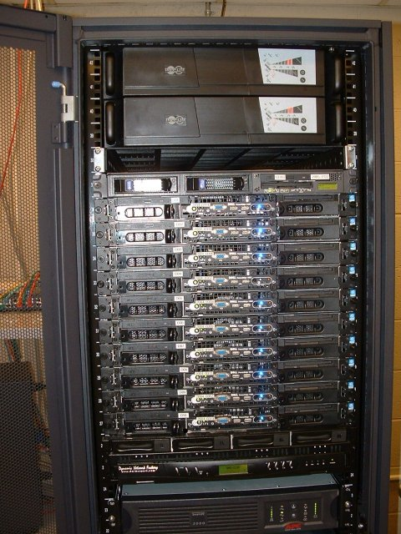
Server-Class Hardware
More internal space.
More CPU/Memory.
More / high-end CPUs.
More / faster memory.
High performance I/O.
PCIe/x vs. PCI
SCSI/FC vs. IDE/Sata
Rack mounted (typically)
Redundancy
RAID Storage arrays / Hot-swappable hardware.
Highly Tested, Certified
Management interfaces

Slide 12
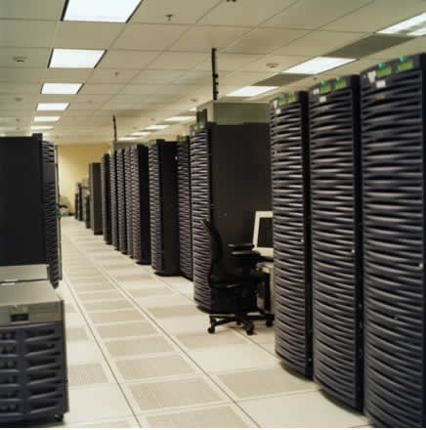
Servers belong in a server room!
Servers should be kept in their own rooms: data centers
DC’s are special homes for servers
They have:
Adequate power
UPS / Generators
Fire Suppression
Air Conditioning
Networking
Physical Security
More on data centers later in the semester
Notes:
Picture of the google data center.

Slide 13
Nobody likes to work in a data center
They’re cold, noisy and cramped.
Efficient space for servers, no so much for people!
Remote Administration is key
Access to system consoles remotely
SSH / VNC on Linux
Remote Desktop on Windows
Hard Boot (Power On/Off ) servers can be problematic
Media insertion can be an issue, too.
There’s a Data Center Unit Later in the course, so more is to come.

Slide 14
Maintenance Contracts
Let’s face it, hardware fails. Longer running time ➔ Greater chance of failure
Hardware on maintenance contracts will guarantee replacement parts and may even include a service dispatch technician (on site).
Mission critical servers should have 2-4 hour response, on-site coverage. NBD, SBD, 9x5, 24x7,4 hours, 2 hours.
2 Hour response means vendor will respond within 2 hours.
Having spare parts on hand, “on the shelf” is a common practice.
Service contracts can be purchased from the hardware vendor, but also from 3rd parties.
Notes:
NBD – next business day
SBD – same business day

Slide 15
What is most likely to fail on a server?
Anything with “moving parts”
#1 – Disk Drive (lots of moving parts)
Redundant Disks RAID 1, 5, 6 are common
Server keeps working despite disk failure
Most servers have hot-plug in / hot-spare technology
Good idea to keep a spare disk on the shelf “OTS.”
The more disks in your RAID, the better the performance.
#2 – Power supply (fans, power surges)
Redundant power supplies means server can continue to operate if one PS fails.
Most Servers have hot plug-in technology for PS
Redundant PS’s should have separate power cords on separate power sources.
#3 – Network Interface Card (NIC)
Redundant NIC’s with automatic failover are common.

Slide 16
Server Virtualization – Are you Hip?
http://www.youtube.com/watch?v=57XDSrwEdRg

Slide 17
Virtualization of Servers
Problem with physical server hardware is:
Management, the more servers you have, the harder they are to manage.
It can be grossly under-utilized in CPU, Memory or Storage for a given service
When it goes over resource capacity, you need to buy new hardware or upgrade.
Space, physical servers require more space in your data centers.
Organizations have been turning to virtual server infrastructure to address these limitations.
Capacity can be scaled up or down based on the needs of the service at the times they are required
Maximizes the investment in hardware – get the most bang for your buck.
Makes it easer to power on/off servers and deal with media insertion issues.
Virtualized servers have the same hardware configuration

Slide 18
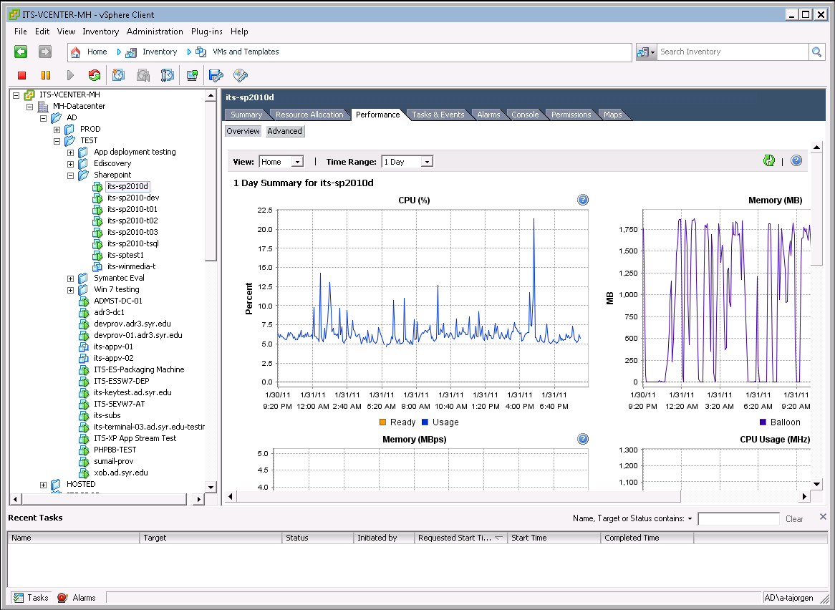
SU virtual server infrastructure

Slide 19
Types of Servers: Hardware Options Operating Systems

Slide 20
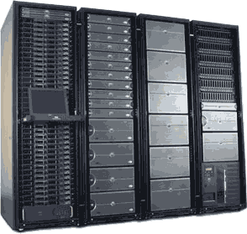
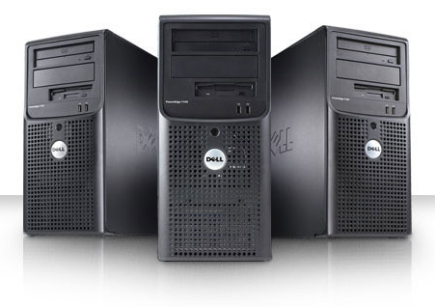
Rack Mountable Servers
Server hardware in configured in to fit in a Rack chassis.
Measured in Rack Units (U’s)
Servers Accessible via Front/Back
Server can be maintained, repaired and upgraded while in the rack.

Slide 21
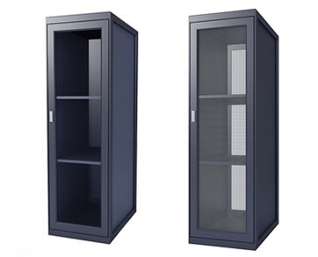
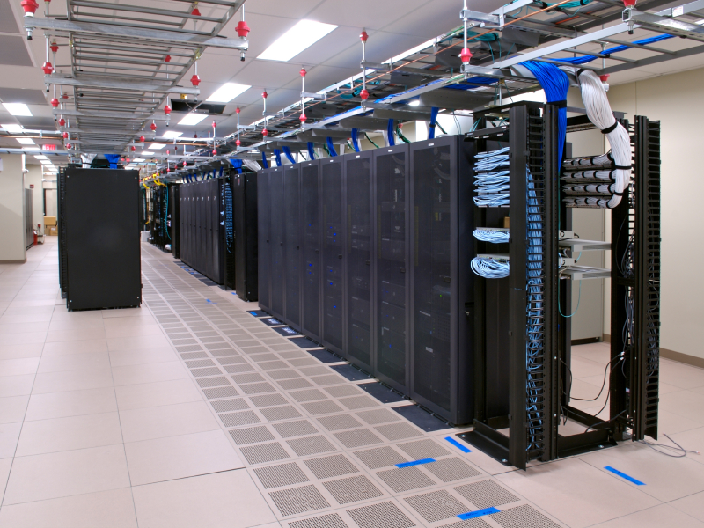
Does it take long to rack servers?
Let’s see the process in high-speed: http://youtu.be/xs6mWS2Jv-Y

Slide 22
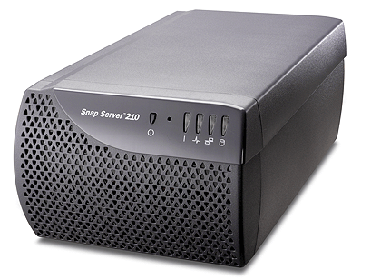
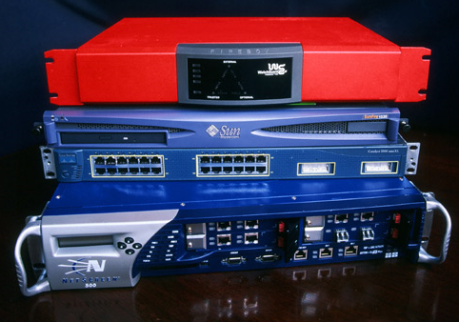
Server Appliances
A server appliance is dedicated hardware and software
The appliance fits a specific role: File Server, Web server, Load Balancer, Firewall, Router, etc.
You can use a OTS server to perform these tasks, so why buy?
Advantages:
Easy to setup, Reliable, Performance
Disadvantages
Cost, Integration

Slide 23
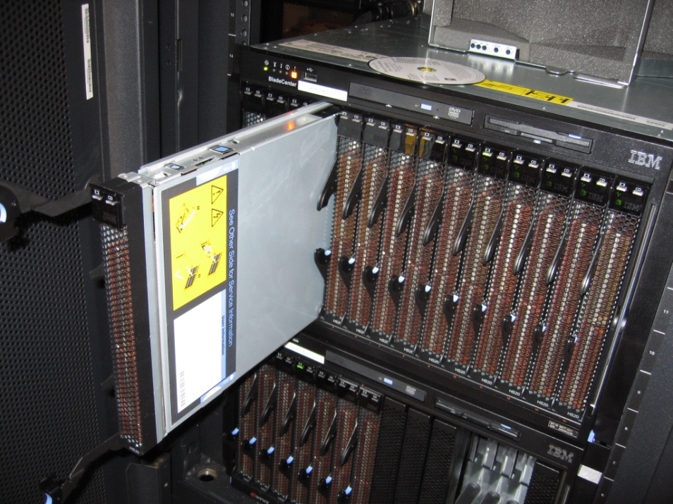
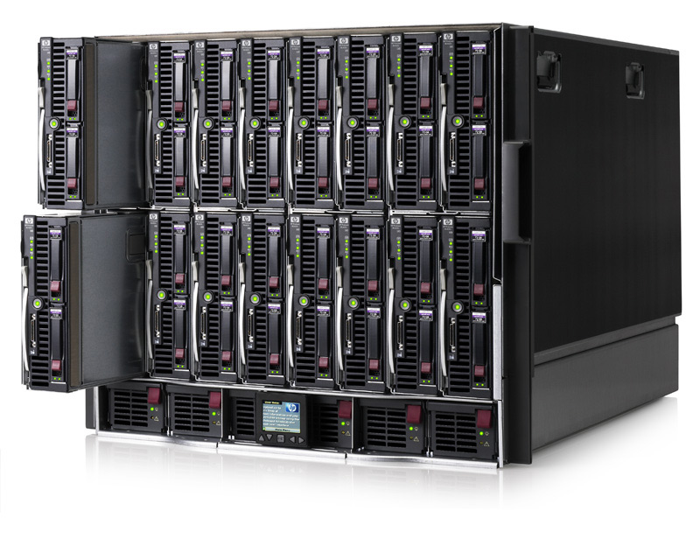
Blade Servers
Very high density: They offer the maximum horsepower for the allotted space.
Pros:
Flexible
High-Performance
Can Grow with your needs
Cons:
Expensive
High power / cooling demands
Vendor Lock-in

Slide 24
Server Operating Systems
Unix-Like:
Ubuntu, Red Hat Enterprise, Sun Solaris, IBM AIX
Windows
Windows Server 2003 / 2008 Standard, Enterprise, and Datacenter editions.
Embedded Operating Systems in appliances
Used in appliances: Routers, Firewalls, Load Balancers, Video streaming, etc.
Linux, FreeBSD, Windows
It should be noted that each operating system specializes at different services, and no one OS is good at everything.

Slide 25
Finally a word from our sponsor:

Slide 26
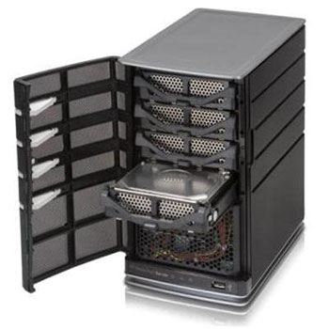
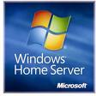
Servers: Not just for business anymore

Slide 27
Questions?
If lawyers are disbarred and clergymen defrocked, doesn't it follow that electricians can be delighted, musicians denoted, cowboys deranged, models deposed, tree surgeons debarked and dry cleaners depressed?

Slide 28

IST346:
Data Centers

Slide 29
Data Centers
What is a datacenter?
Page 129, “ a data center is a place where you keep machines that are a shared resource”
A.K.A
Server room
Machine room
Server closet (hopefully not literally a “closet”)

Slide 30
Data Centers - Options
Build
Rent
$100 - $400 per square foot to build
This is known as a “co-location Facility”
IaaS
Paas
you don’t care about the physical servers, just the services running on them. Everything you do is for the services.

Slide 31
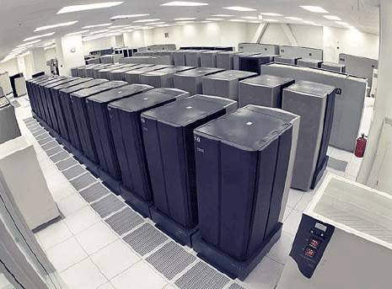
Data Center- Major Components
What makes a data center more than just a closet with a bunch of servers?
Location
Access
Security
Power, Cooling, Humidity
Fire Suppression
Racks
Cable Management
Communications
Console Access
Workbench
Tools, parts, etc

Slide 32
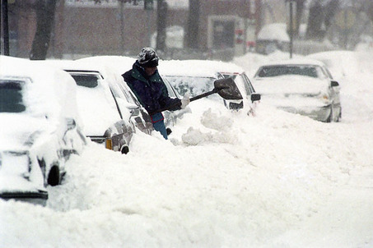
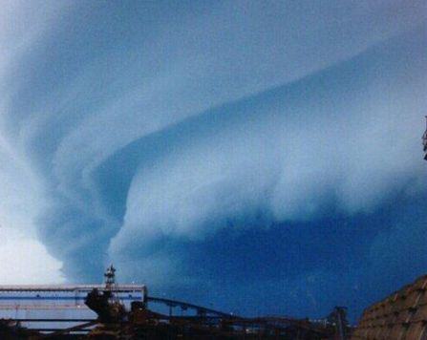
Location
Talking geography and on site.
If your area is susceptible to flooding, don’t put your data center in the basement.
“One company I’ve read about has two data centers, one in Florida and one in Colorado. They change primary data centers every 6 months.”
Why?
Florida → hurricanes
Colorado →snow storms.

Slide 33
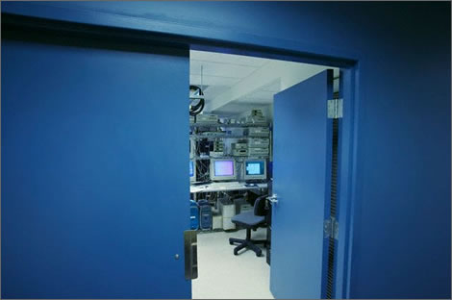
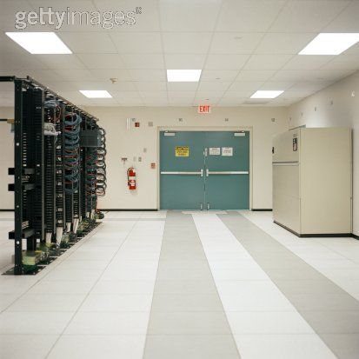
Access
What type of access is required?
Wheelchair, ramps, loading docks to unload equipment?
Some equipment is wider than the average sized door. Need double-doors.
Restrict access to people who don’t need it.

Slide 34

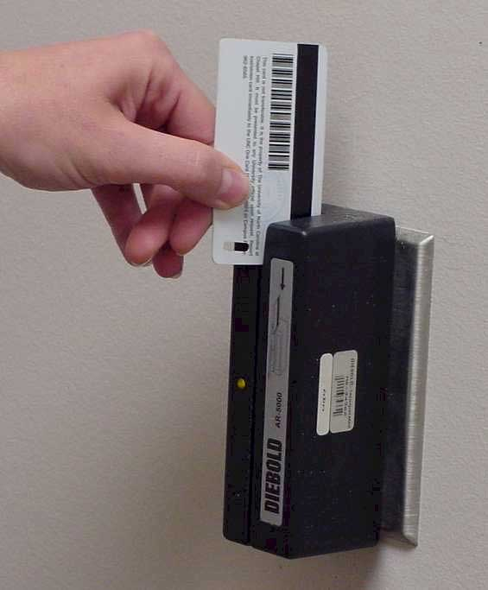
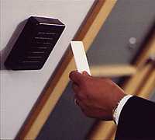
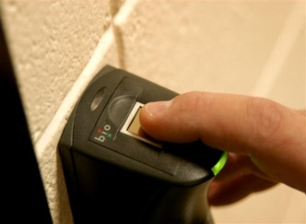
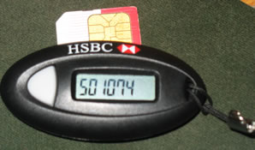
Security
What type of security do you require?
Numeric key pads – bad idea. Anyone can share the code. No way of knowing who came in.
Keys, - better, at least you know who you gave the key to originally
Card swipes – even better, logs entry information and controls access
Proximity detectors – better still, same advantages as card swipes but more convenient
Biometrics – almost there. Thumb print reader or voice recognition. Disadvantages ?
Two Factor, -best, something you have and something you know. A numeric keypad that requires both a static or non-changing code and a one-time-password security token.

Slide 35
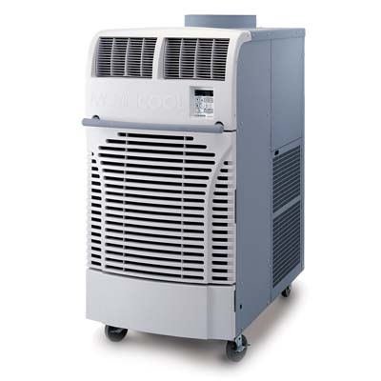
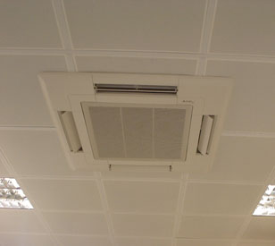
Cooling
For every watt of power used in the data center, you need to plan for the same amount of power to cool your equipment.
Direct your cool air where you need it
New types of cooling concepts, “cool the servers, not the entire room” (SU Green DC)
Rear door heat exchangers. Cools only the servers and not surrounding room air. Most efficient.

Slide 36
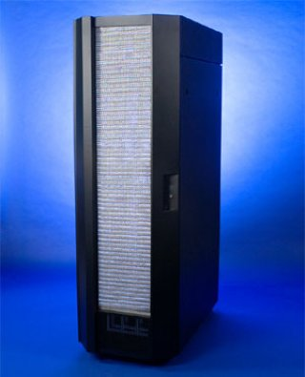
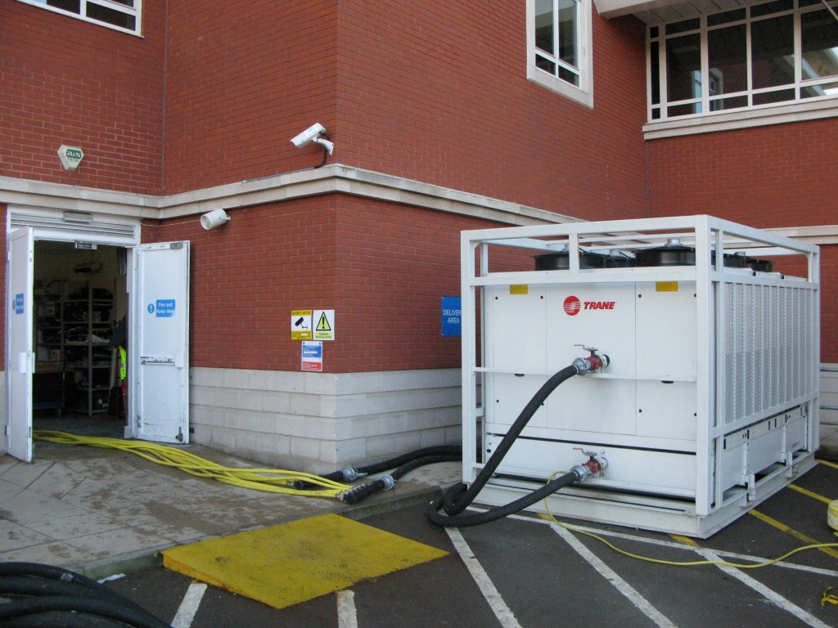
Large Data Center Air Conditioner and Rear Door Heat Exchanger

Slide 37
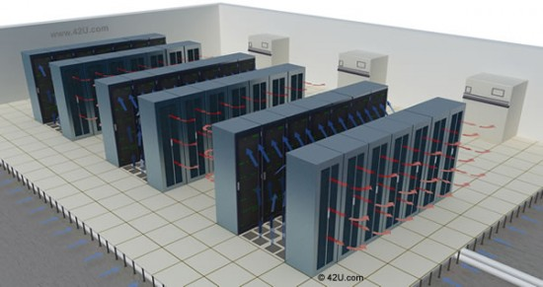
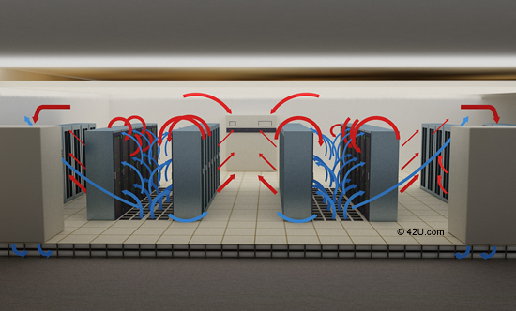
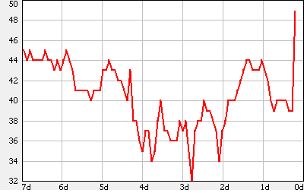
Hot and Cold Isles and Humidity
Cold air goes in front of rack, heated by server, exited out back.
Arrange your data center so the backs of the racks are towards each other. This forms hot and cold isles.
Easier to collect the hot air. Heat rises.
Keep server room humidity between 45% - 55%. Too low, static, too high, condensation.

Slide 38
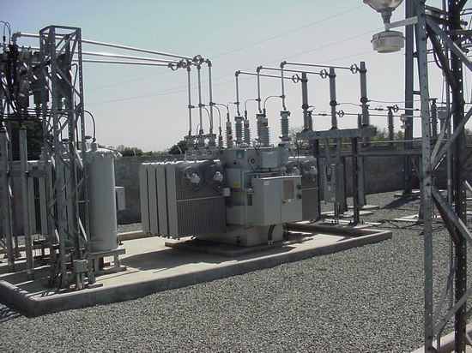
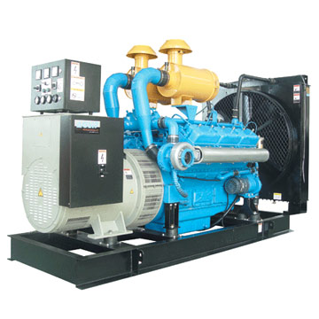
Power
Multiple sources of electricity.
Multiple feeds from multiple substations.
Generator, not only for emergencies but also for normal operations.
What type of power does it produce, do you need? 110V, 220V, 480V?
Discussion is driven by what type of power your servers require. Not all servers require 110V “standard line power”.
Can you use DC power? 240 Volts? More efficient than 110V. Save up to 4% in electric usage.
Be “Green” in your data center. Where does your electricity come from?

Slide 39
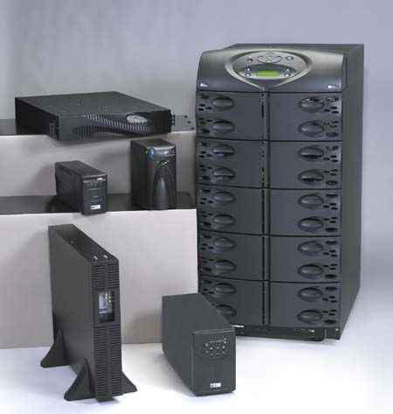
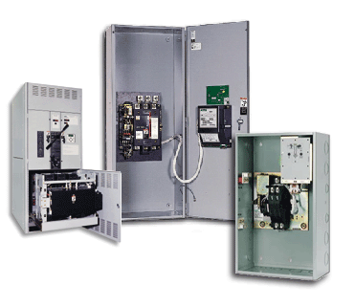
Power
Do you have a Uninterruptable power supply (UPS)? How big?
How long does it need to last, 10 minutes, 1 hour, 4 hours?
Varies depending if you have a generator or not.
Do you have automatic transfer switches, (ATS)?
Switches that ‘sense’ if line power or in Syracuse, National Grid power if present, and if not, automatically starts generator and transfers load. When line power returns, shuts off generator and returns load to line power.

Slide 40
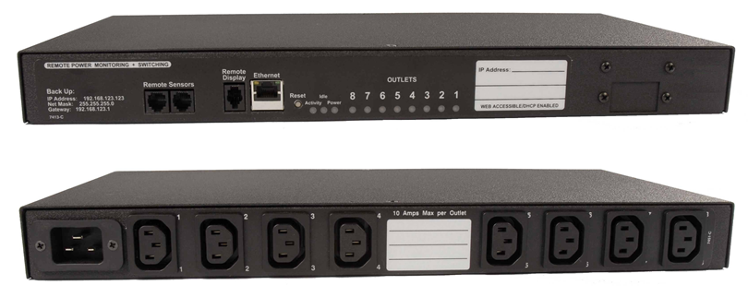
Power Distribution Unit (PDU)
Looks like a power strip, much more.
Can be horizontally or virtually mounted
Monitor, record, and control each outlet remotely via network.
Should have two per server, one connected to line power and one connected to UPS / Generator power
A PDU is not a UPS. They’re different.

Slide 41
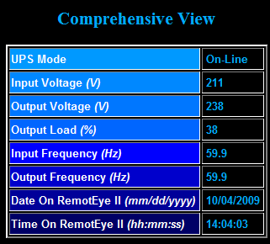
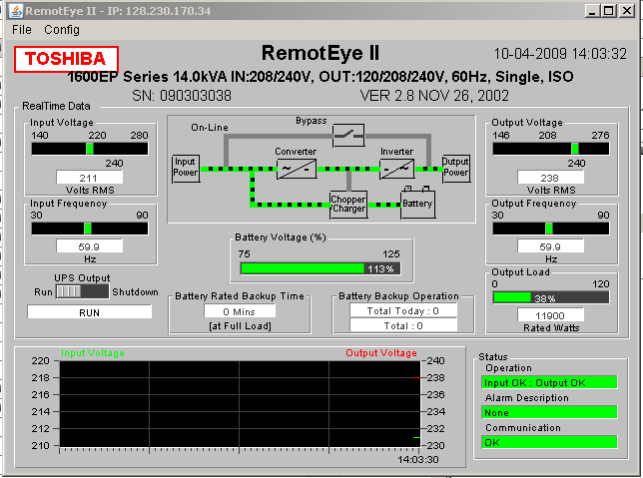
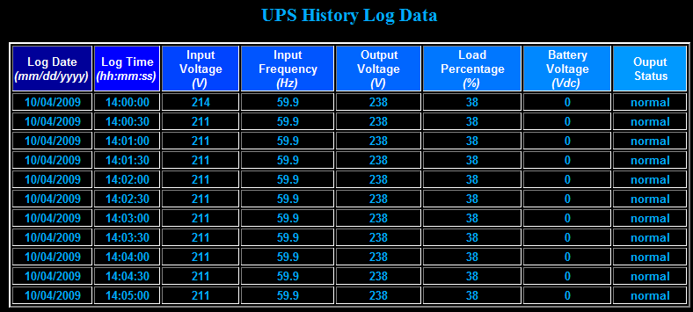
Monitor your Power

Slide 42
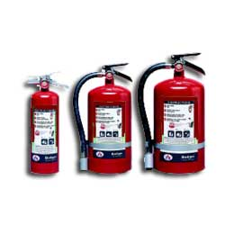
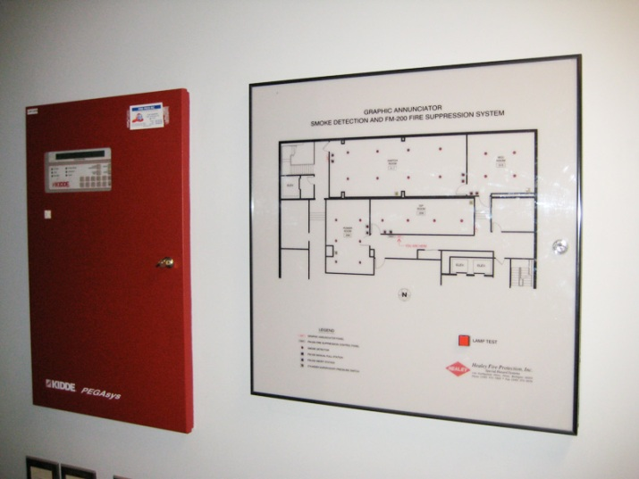
Fire Suppression
Require Fire suppression methods; required by law /code
Conventional (Water and Sprinklers) = Bad
Many other methods
CO2 & Halon, good for servers, bad for people
Conventional extinguishers
Consult local fire authorities
Cost plays a large factor.

Slide 43
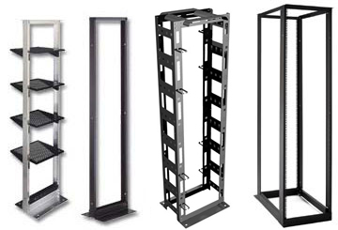

Racks
The ‘spine’ of the data center
Dictate other components
Wiring, cooling, power, etc
Not inexpensive, up to $10,000 per rack with required products (power, cooling, networking, etc)
Standard 19” wide, width of standard mountable equipment. 19” between posts.
Some telecomm equipment is wider. Special order
May purchase racks wider and deeper than your needs as to leave room for networking, power, cooling, etc.
2 or 4 posts
4 is better but more expensive.
Rack equipment in U’s or rack units,
1.75 inches per “U”
Can use square nuts or screws to mount equipment

Slide 44




Rack Cooling
Racks are typically open at the bottom to allow cool air to flow in.
Heat rises exits out the back
Not a location to run wires. Run cabling overhead with above-the-racks wire trays
Keep doors and sides on if using raised floor, off it using standard air-conditioning
Monitor temperature inside racks
iSchool uses a device called “Weather Goose”

Slide 45


Racks Determine Cable Management
A good cabling job is a pleasure to work with.
Don’t ‘build-your-own’ cables. Purchase cat6 (category 6) cables.
Purchase special cable management products.
Easily identify which cable connects to what.
Color code or label your cables
Separate power from network cables. Power down one side, network cables down the other

Slide 46



Cable Management Images

Slide 47
Come up with cabling Guidelines
Blue / Green – production network
Red / Orange – storage network (iSCSI)
Yellow – KVM
White – Private NAT

Slide 48

And why do we need cabling guidelines?
Bob, can you connect the email server to the new storage device, it’s the yellow wire.

Slide 49
Communications
Put a telephone in your server room incase you need to call someone in for assistance or be speaking with a vendor while standing in front of the server.
“Bridge” the telephone line into a infrequently used circuit to save money.
Don’t rely on cell phones. Can be difficult to hear plus more interference in server room.

Slide 50

Console Access - KVM
Discussed already
In-band vs. out-of-band management
KVM usage
If no KVM or out-of-band management, consider using a ‘crash cart’ or setup cart.
Basically a vertical cart with a keyboard, mouse, and monitor used when 1st setting up servers or if they crash so bad you can’t use other management techniques

Slide 51


Workbench, Tools, Parts
Have a place where your staff can test out or ‘burn in’ a server before putting it into production.
Place to troubleshoot failed servers
Have extra patch cables, nuts, bolts, “spare parts” on hand.

Slide 52


Alternative data centers
Sometimes you have to think “outside the box”…or in these cases, in a different box!

Slide 53
Summary
Data center is much more than a standard room or closet.
Many things make a server room unique.
$100 / $400 or more per square foot to create a server room.
Look for alternatives, outsource
If you are going to build it, do it right the first time.

Slide 54
Questions?
“There are 10 kinds of people in the world, those that understand binary and those that don’t”

